Slide 1
ALGEBRA 4
Day 47

Slide 2
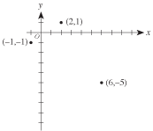
Bell Work
In the standard (x,y) coordinate plane below, 3 of the vertices of a rectangle are shown. Which of the following is the 4th vertex of the rectangle?
(3,–7)
(4,–8)
(5,–1)
(8,–3)
(9,–3)

Slide 3
From Last Time (need time to work)
page 300 #1-9, 17, 25-31 (odd), 37, 51-52

Slide 4
Quiz
Half Sheet of Paper

Slide 5
5.4 Dividing Polynomials
Objectives:
To Divide Polynomials Using Synthetic Division.
To know that Long Division exists.

Slide 6
To Divide Polynomials:
Write polynomial in standard form
Put 0’s in for missing parts
You have to remember 0’s as place holders!!!!

Slide 7
Long Division
Allows you to divide any polynomial by another polynomial
The process is long, thus the name, and we have better options
If you want to see it… I can show you another time! ☺

Slide 8
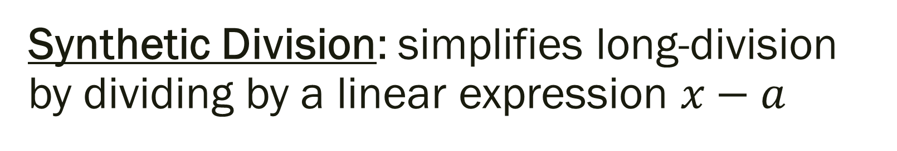
Synthetic Division: simplifies long-division by dividing by a linear expression $x−a$
Steps to using Polynomial Synthetic Division:
Write the equation in standard form
(put 0’s in for exponents not represented)
Multiply leading coefficient by the value of the variable
Sum the next coefficient with the answer from Step 2
Multiply the answer from Step 3 by the value of the variable
Sum the next coefficient with the answer from Step 4
Continue until each coefficient has been used

Slide 9
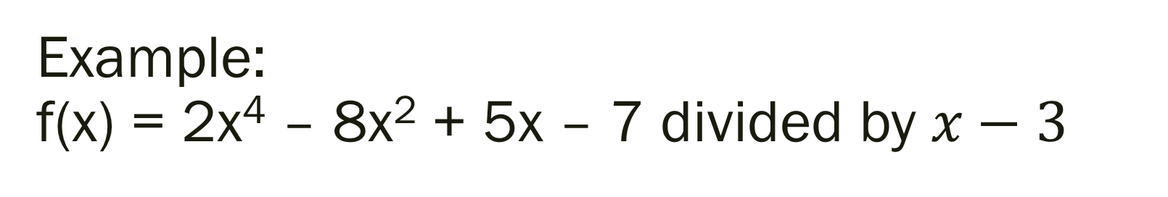
Example: f(x) = 2x⁴ – 8x² + 5x – 7 divided by $x−3$

Slide 10
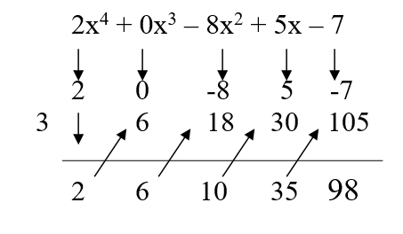

Example: f(x) = 2x⁴ – 8x² + 5x – 7 divided by $x−3$
2x⁴ – 8x² + 5x – 7 = (2x³ +6x² + 10x +35)(x-3) + R: 98

Slide 11
Remainder Theorem; If a polynomial f(x) is divided by x – k, then the remainder is r = f(k)
Based on the last problem…
By the Remainder Theorem, f(3) is the remainder when you divide f(x) by x – 3
f(3) = 98

Slide 12
Is (x+5) a factor of x³ +7x² -38x – 240? If yes, what are the other factors? If no, what is the remainder?

Slide 13
Is (x+5) a factor of x³ +7x² -38x – 240? If yes, what are the other factors? If no, what is the remainder?
Since you get a remainder of 0 when doing synthetic division, then (x+5) is a factor
The other factors are (x+8) and (x–6)
Therefore, x³ +7x² -38x – 240 = (x+5)(x+8)(x–6)

Slide 14
For Next Time
Page 308 #1-7, 11-25 (odd), 29, 33-37 (odd), 41
(Extra Practice #44-62)

